Slide 1


Predictive Maintenance: RUL Prediction
Nisarg Nigam

Slide 2

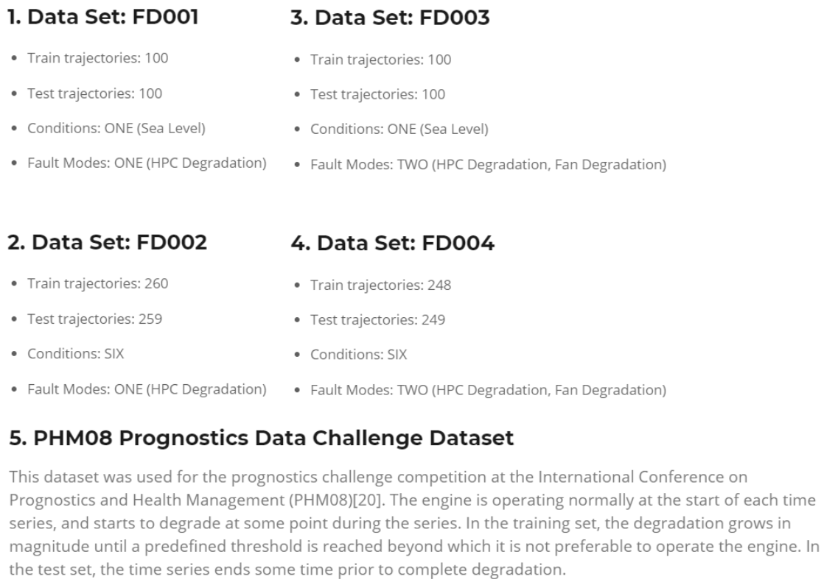

Dataset
A. Saxena and K. Goebel (2008). "Turbofan Engine Degradation Simulation Data Set", NASA Ames Prognostics Data Repository (http://ti.arc.nasa.gov/project/prognostic-data-repository), NASA Ames Research Center, Moffett Field, CA

Slide 3


Slide 4
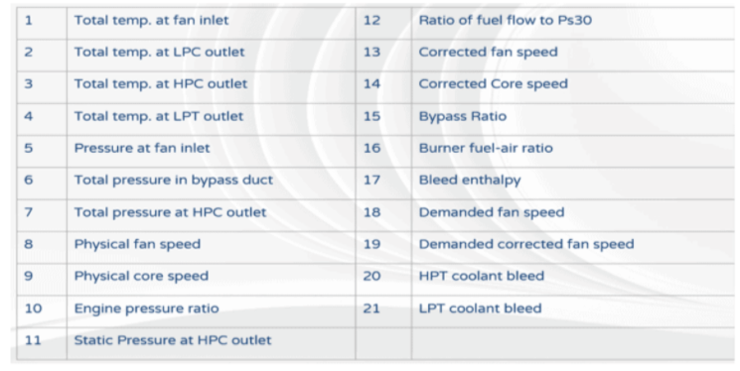
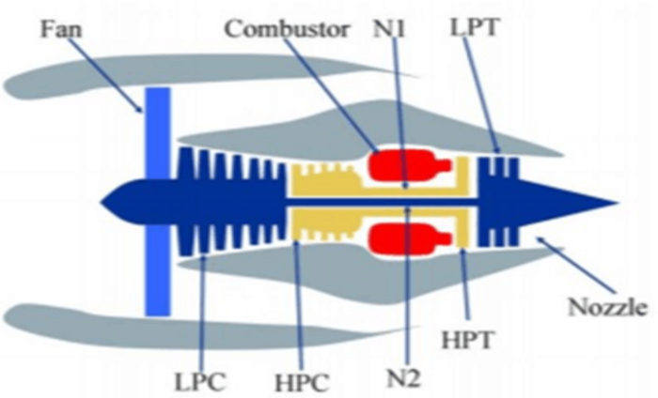
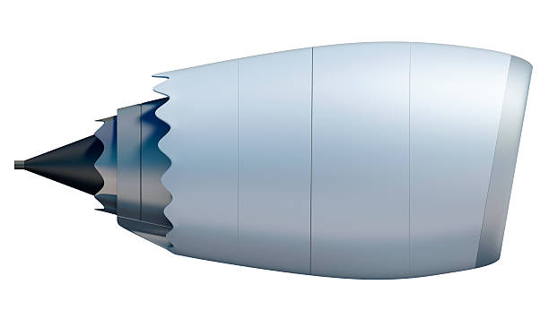
Sensors

Slide 5
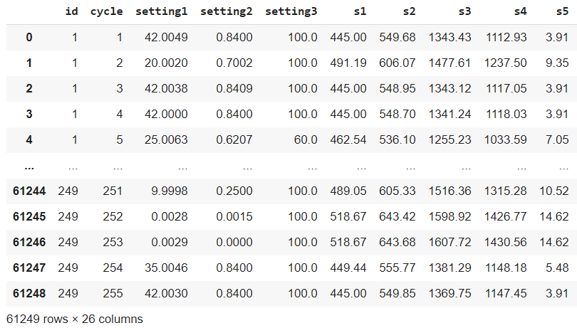
Data view

Slide 6
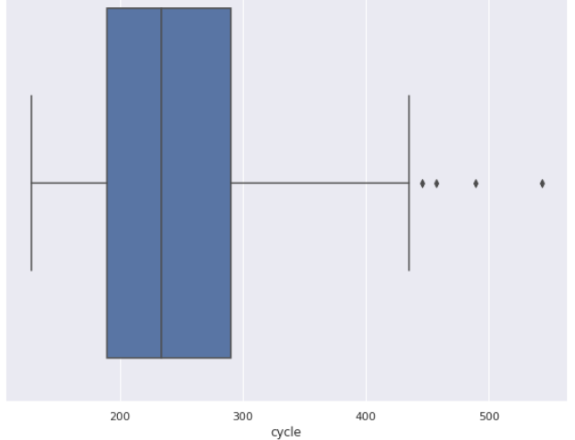
Distribution of CYCLE Lengths

Slide 7

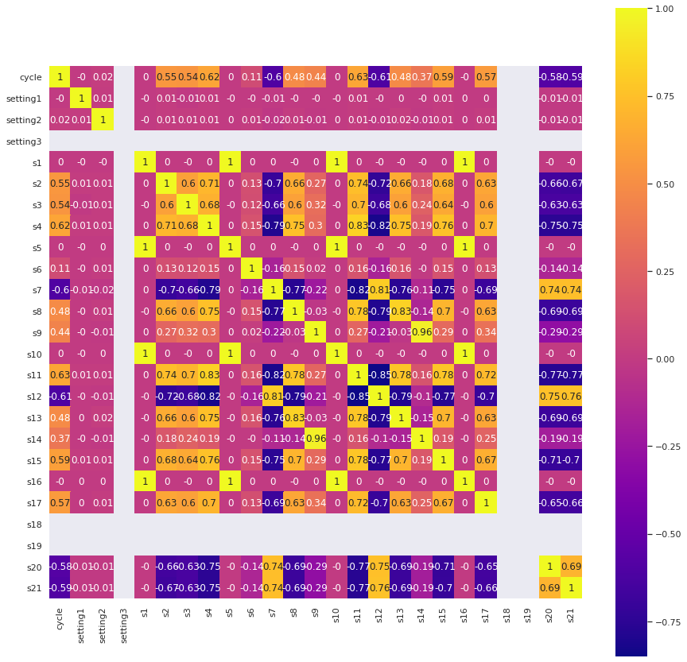
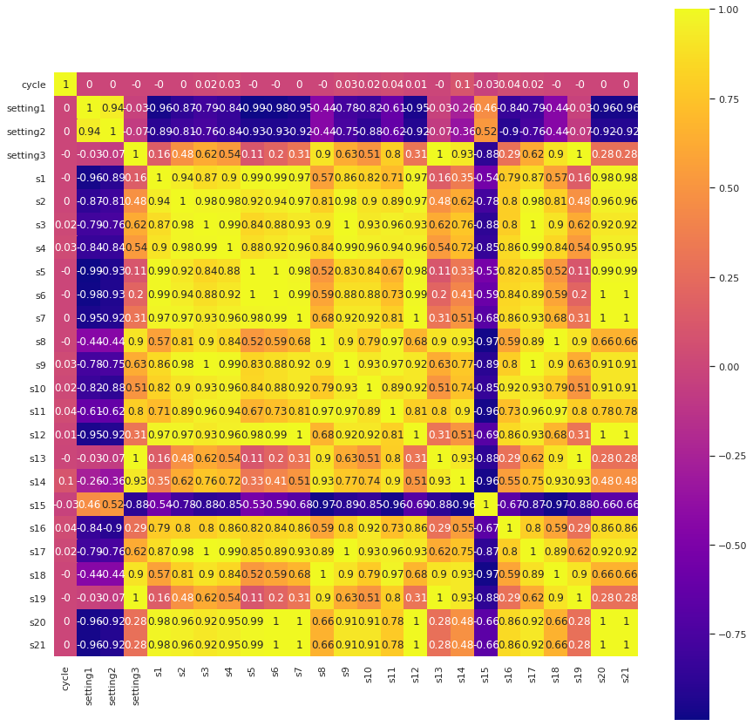

Slide 8
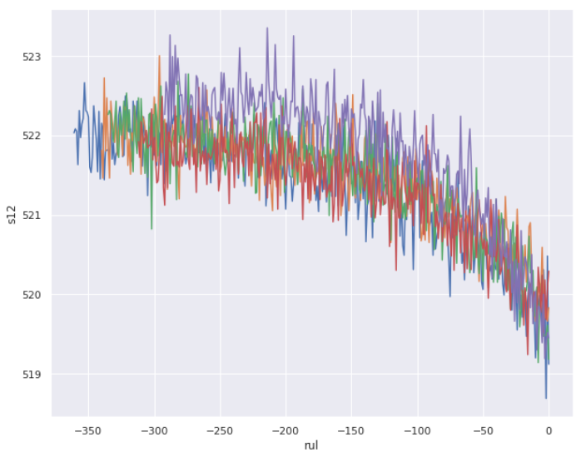
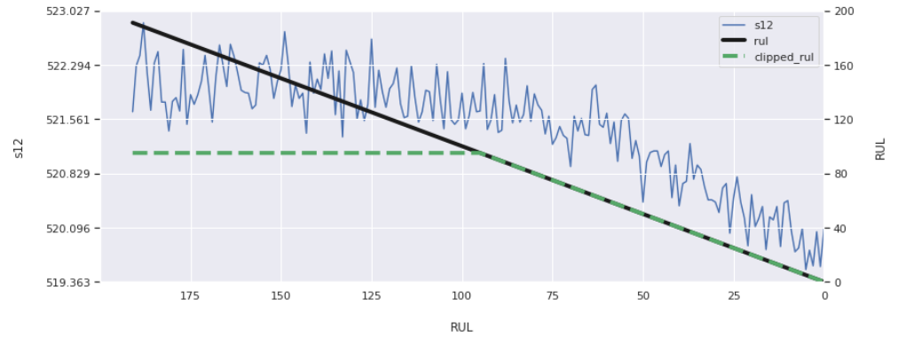
Single sensor RUL

Slide 9
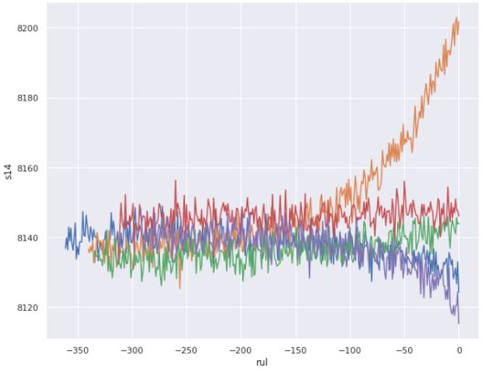
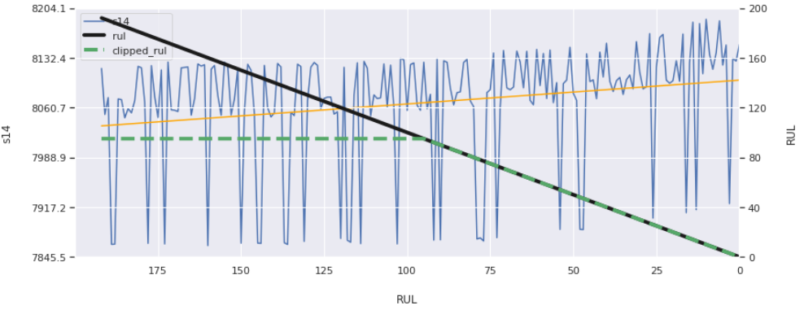
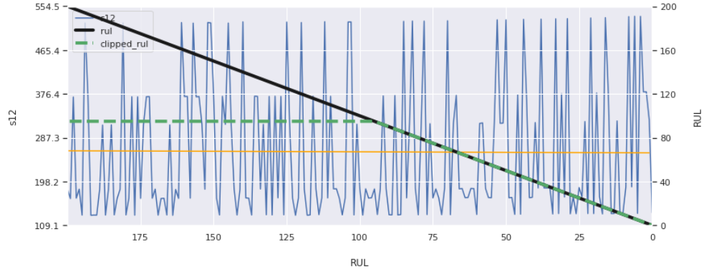
Complications

Slide 10


Competitive Results
Rank | RMSE
1 | 12
2 | 15
3 | 16
4 | 16.4
5 | 18
6 | 18.3
7 | 20
8 | 18
9 | 19
10 | 19
Methods:
Similarity Based
Multi Layer Perceptron and Kalman Filter Based Approach
RNN
Different method to score to penalize above and below target differently

Slide 11
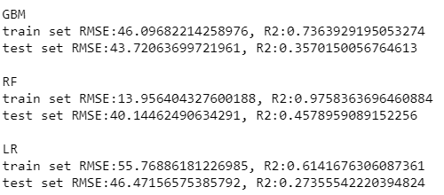
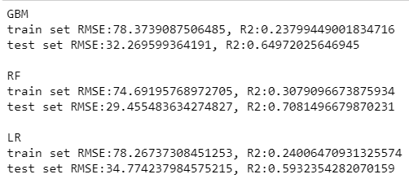
Simple ML results
Y_train VS Y_train_clipped

Slide 12
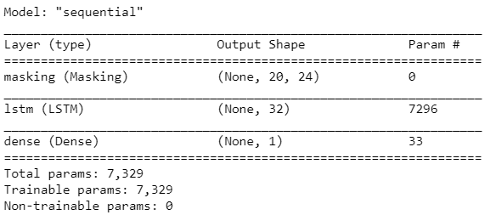
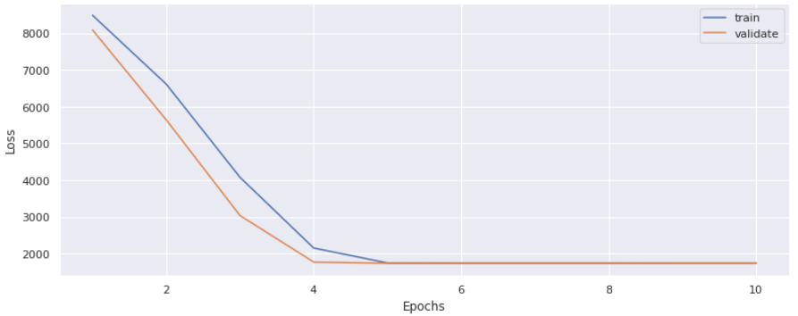
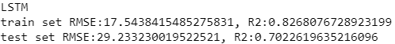
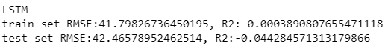
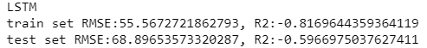
NN ML Results

Slide 13
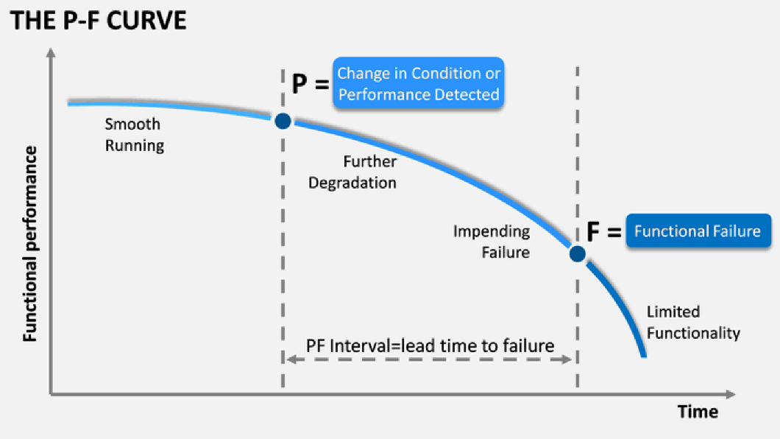
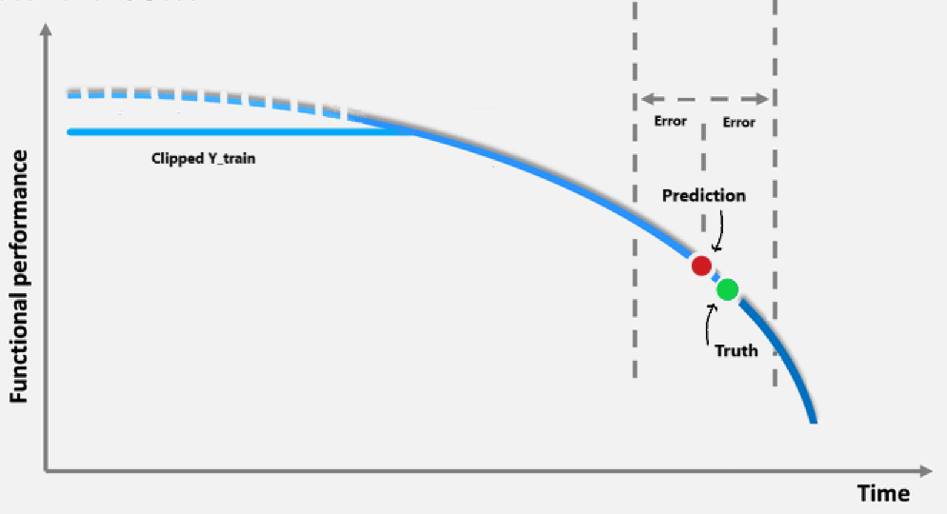
Insights
How to use the predictions when there is such an error?
Prediction Interval

Slide 14
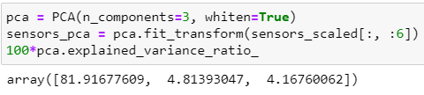
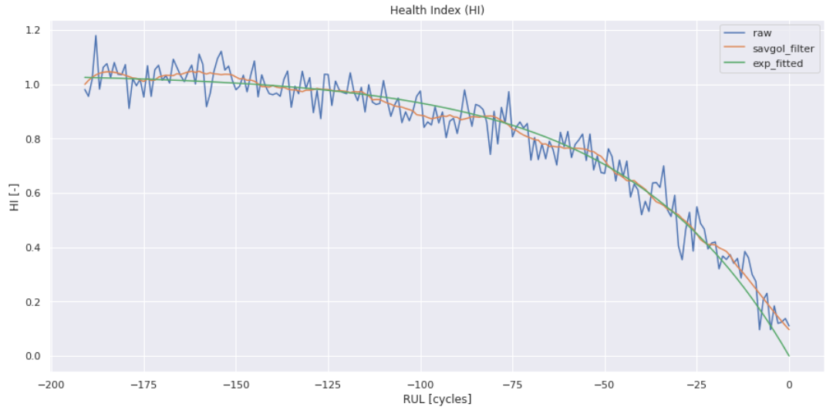
Fusing Sensors
PCA to fit 3 components

Slide 15
IMPROVEMENTS
Different Methods to create the test set
Mean of last few rows
Median
Weighted variations
Add select past cycles and their sensor rows as X columns as well
Feature Engineering
Hyperparameter Tuning
Use Health index curve on test dataset

Slide 16
References:
Alhamaly, A. (2019, August 28). Jet Engine Remaining Useful Life (RUL) Prediction. Retrieved January 05, 2021, from https://medium.com/@hamalyas_/jet-engine-remaining-useful-life-rul-prediction-a8989d52f194
Peters, K. (2020, September 7). Predictive maintenance of turbofan engines. Retrieved January 05, 2021, from https://towardsdatascience.com/predictive-maintenance-of-turbofan-engines-ec54a083127?source=friends_link
Emmanuel Ramasso, Abhinav Saxena. Performance Benchmarking and Analysis of Prognostic Methods for CMAPSS Datasets.. International Journal of Prognostics and Health Management, 2014, 5 (2), pp.1-15. ffhal-01324587f

Slide 17

Thank You!

